Slide 1
Genomic architecture of inflammatory proteins
https://github.com/jinghuazhao/INF
On behalf of the SCALLOP/INF1 consortium
3/5/2019

Slide 2
Introduction
The vital role of inflammation is well-established in immune response and increasingly recognised in a range of pathological processes and diseases (Genz et al 2016, Niewczas et al. 2019).
The Olink/inflammation proteins combined with genomic data offer great opportunities to investigate the underlying biology (Sun et al. 2018). We therefore conducted genomewide association meta-analysis on Olink/Inflammation proteins from 12 studies within the SCALLOP consortium.

Slide 3
Methods
Genotypes. 1000Genomes, HRC or UK10K+1000Genomes imputed genotypes.
Proteins. inverse normal transformed Olink/inflammation.
Model. Additive genetic model with adjustment for sex, age, principal components and/or cohort-specific covariates.
Meta-analysis. Per-SNP meta-analysis on effect sizes through METAL.
Independent signals. PLINK clumping and joint/conditional analysis with GCTA.
1000Genomes and individual level genotype data from INTERVAL were used as LD reference panels.
Approximately independent LD blocks.
Bonferroni correction on genomewide significance 5e-8/92.

Slide 4
Study information
Name | Website | Design | N | Institution
NSPHS | www.ncbi.nlm.nih.gov/pubmed/20568910 | population study Sweden | 866 | Uppsala
Pfizer.trials | www.pfizer.com | rheumatoid | 185 | Pfizer
STABILITY | https://clinicaltrials.gov/ct2/show/NCT00799903 | atherosclerosis | 2951 | Uppsala
STANLEY swe6 | www.ki.se/meb/stanleyswebic-studien | bipolar, depression | 300 | Karolinska
STANLEY lah1 | www.ki.se/meb/stanleyswebic-studien | bipolar, depression | 344 | Karolinska
BioFinder | http://biofinder.se | dementia | 1496 | Karolinska
COMBINE.RECOMBINE | www.combinesweden.se/ | rheumatoid | 860 | Karolinska
Estonian Biobank | www.geenivaramu.ee/en/access-biobank | population study Estonia | 487 | Tartu
INTERVAL | www.intervalstudy.org.uk/ | blood donors England | 4902 | Cambridge
KORA F4 | https://www.ncbi.nlm.nih.gov/pubmed/16032513/ | population study Germany | 1064 | Helmholz
ORCADES | https://www.ed.ac.uk/usher/molecular-epidemiology/our-studies/the-orkney-complex-disease-study | population isolate Orkney | 981 | Edinburgh
VIS | https://www.ed.ac.uk/usher/molecular-epidemiology/our-studies/croatian-studies | population isolate Croatia | 899 | Edinburgh
Total |  |  | 15335

Slide 5
Association analysis for KORA
Pilot with success/failure with BOLT-LMM on OPG/TNFSF14
Switch to SNPTEST on transformed measurement ~ age+sex+PC1-PC5
Exclusion of six related individuals
INFO score was compared between SNPTEST and qctool –snp-stats
Final sample size N=1,064
Several disruptions on cardio/TRYGGVE and FGF.5 for #SNPs

Slide 6
Meta-analysis (METAL)
TACKPOSITIONS/CUSTOMVARIABLE with 2018-08-28 release.
~ 36hr on TRYGGVE.
No GC correction (polygenicity/population stratification) on individual studies.
Effect size-based (could be compared with p/N counterpart).
N>=10.

Slide 7
Quality control of meta-analysis (IFN.gamma)
QCGWAS only desirable for small (esp. problematic) number of proteins.
Manhattan plots were produced for each protein from each cohort.
It indicates that sumstats are generally satisfactory.

Slide 8

Manhattan plots

Slide 9

Q-Q plot

Slide 10

Busy example of IFN.gamma ylim=c(0,25)

Slide 11
Associate information on LLOD
An attempt was made by using llod/2.
Busy Manhattan plots were largely related to this.
Although higher MAF cutoff could do away with busy (excessive number of significant hits) Manhattan plots, the associate proteins with low >LLOD% were discarded.

Slide 12
Busy Manhattan plots and % (above LLOD)
Protein | % | Protein (continued) | % (continued)
L.15RA | 0.841 | IL13 | 0.062
ST1A1 | 0.808 | IL.20RA | 0.057
MCP.3 | 0.804 | IL.24 | 0.051
FGF.5 | 0.652 | IL.20 | 0.046
AXIN1 | 0.425 | NRTN | 0.039
IL.17A | 0.380 | ARTN | 0.035
IL.17C | 0.369 | IL.1.alpha | 0.025
IL4 | 0.171 | IL.2RB | 0.023
IL5 | 0.162 | IL33 | 0.014
IL.10RA | 0.149 | IFN.gamma | 0.007
TNF | 0.096 | TSLP | 0.005
LIF | 0.064 | IL.22.RA1 | 0.003

Slide 13

IFN.gamma from >1,000 signals to none

Slide 14
Identification of near-independent signals
1KG (LocusZoom 1.4, cardio), and UK10K+1KG as LD references, with (experimentally) balanced and comparable parameters, i.e.,
PLINK --clump-r2 0.1 can also give overlap with approximately independent LD bocks (see INF1.UK10K+1KG.AILD.r2-0.1.ranges).
GCTA --cojo-collinear 0.9 gives near-independent (primary + secondary) signals..
INTERVAL and INF1 share similarity in both number of signals and cis/trans classification, while UK10K+1KG reference panel gave more signals than 1KG.

Slide 15
Results
Manhattan, Q-Q, LocusZoom (rsid instead of SNPID)/forest (right allele labelling/effect size).
Identification of near-independent signals with 1KG (built from LocusZoom 1.4 and also curated databases at cardio), UK10K+1KG (INTERVAL genotypes) and contrast with INTERVAL.
Cis/trans classification of signals.
Replication of findings on OPG (Kwan et al. 2014) through PhenoScanner.
Finemapping, LDSC analysis, pathway analysis?
Quantitative trait/disease outcomes, e.g., CVD, lung function.

Slide 16
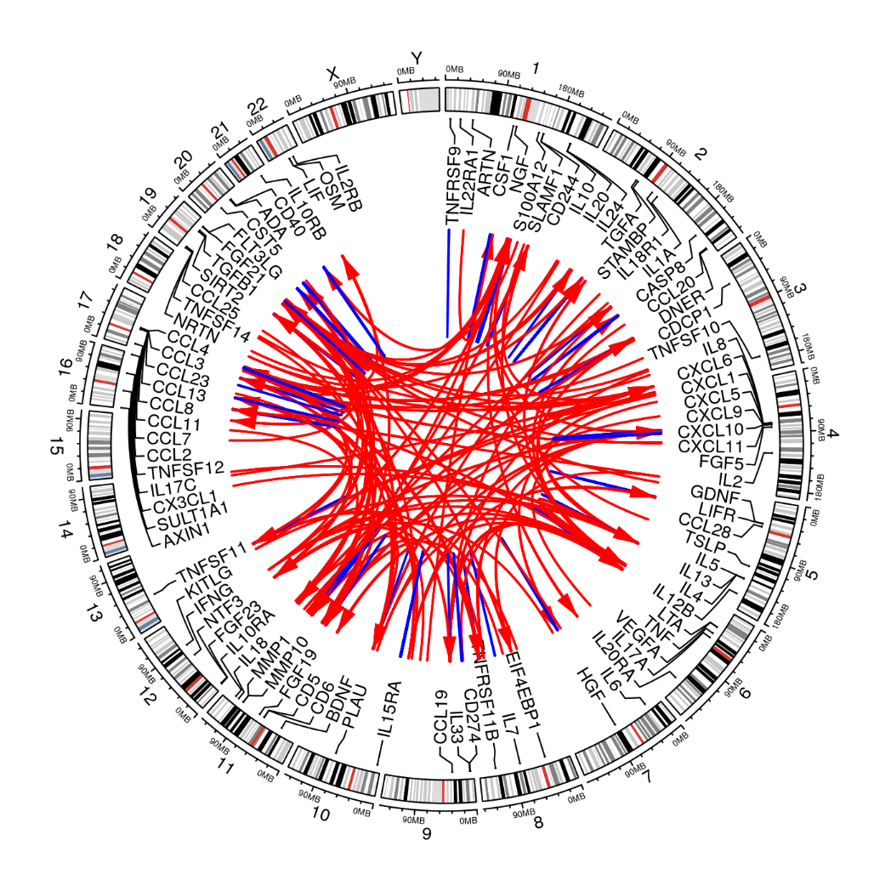
410 Signals
380 primary+30 secondary signals.
Proteins |  | Signals
only cis pQTLs |  | 13
only trans pQTLs |  | 14
both cis and trans |  | 45
no pQTL |  | 20
 |  | 92
228 cis/182 trans signals

Slide 17
Annotation by PhenoScanner
PhenoScanner 1.1 at cardio identifies earlier work on OPG by Kwan et al. (2014).
Additional results on IBD, rheumatiod arthritis.

Slide 18

Manhattan plot (OPG)

Slide 19

Q-Q plot (OPG)

Slide 20

Regional plot (OPG, chr8)

Slide 21

Forest plot (OPG, chr8)

Slide 22

Forest plot (OPG, chr17)

Slide 23
Conclusion
Our joint/conditional analysis took full advantage of the approximately independent LD blocks which helps to resolve the uncertainty in LD-window specification in the literature. The specific findings on OPG was just an example that we would be able to replicate earlier work but on a greater scale. Our findings will corroborate with related work on broad spectrum of proteins as reported in Sun et al. (2018) as well as findings related to inflammation on the SomaScan panel used (Niewczas et al. 2019).
Our GitHub repository, https://github.com/jinghuazhao/INF, provides additional information which will also facilitate analysis from other panels in the SCALLOP consortium. Other downstream analysis will be reported separately.

Slide 24
Outlook of the analysis
Discovery, replication – INTERVAL, meta-analysis, NSPHS.
PLINK –clump has 932/628 (~1M/~2M) pending on manual exclusion using LD.
GCTA –cojo analysis on 1KG reference produced 359 near-independent (~1M interval, 305 primary + 54 secondary) signals (~10 days on cardio and 62 proteins so far with UK10K+1KG panel), which is preferably intersected with approximately independent LD blocks for finemapping – PLINK, GCTA, finemap, and JAM, among others..
Effect size/MAF plot.
Power/winner’s curse/bivariate LDSC – plots/correlation of effect size and/or pQTLs from INTERVAL vs INF1.
Additional information on genotyping and cohort characteristics needs to be requested for the paper.
Elementary summary statistics such as h2 from INTERVAL, with KORA relatively small for GCTA and possibly with INF1 for HESS. This was examined by Kwan et al. (2014) whose results on OPG were replicated from the analysis.

Slide 25
Other aspects
Between-cohort MAF-MAF plots
P ~ N (for finemapping) and consistency, e.g. INTERVAL/STABILITY.
False negative for those in the CVD1 panel to PhenoScanner.
Chr19. NLRP12 from INTERVAL`
Total # signals relative to other panels.
Phenoscanner and eQTL.

Slide 26
Landmarks
3/5/19 – BHF poster.
27/3/19 – cross-reference with INTERVAL on INTERVAL genotype data, which showed great similarity with INF1, esp. w.r.t. cis signals.
8/3/19 – Recognition of MAF cutoff on IFN.gamma, IL.22.RA1, TSLP.
29/11/18 – 22 proteins with busy Manhattan plots.

